Slide 1
Car Price Prediction
Prepared by
NASIM PATIL

Slide 2
Agenda
Introduction​
Problem Statement
Business Goal
Technical Requirement
Exploratory Data Analysis (EDA)
Data Pre-Processing
Visualization
Built Model
Saved Best Model
Summary​

Slide 3
Introduction
With the covid 19 impact in the market, we have seen lot of changes in the car market. Now some cars are in demand hence making them costly and some are not in demand hence cheaper. One of our clients works with small traders, who sell used cars. With the change in market due to covid 19 impact, our client is facing problems with their previous car price valuation machine learning models. So, they are looking for new machine learning models from new data. We have to make car price valuation model. This project contains two phase:
Data Collection Phase : We have to scrape at least 5000 used cars data. We can scrape more data as well, it’s up to us. More the data better the model. In this section we need to scrape the data of used cars from websites (Olx, cardekho, Cars24 etc.) We need web scraping for this. We have to fetch data for different locations. The number of columns for data doesn’t have limit, it’s up to us and our creativity. Generally, these columns are Brand, model, variant, manufacturing year, driven kilometers, fuel, number of owners, location and at last target variable Price of the car. This data is to give us a hint about important variables in used car model. We can make changes to it, we can add or you can remove some columns, it completely depends on the website from which we are fetching the data. Try to include all types of cars in our data for example- SUV, Sedans, Coupe, minivan, Hatchback.
Model Building Phase : After collecting the data, you need to build a machine learning model. Before model building do all data pre-processing steps. Try different models with different hyper parameters and select the best model. Follow the complete life cycle of data science

Slide 4
Business Goal
One One of our clients works with small traders, who sell used cars. With the change in market due to covid 19 impact, our client is facing problems with their previous car price valuation machine learning models. So, they are looking for new machine learning models from new data. We have to make car price valuation model. This project contains two phases:
Data Collection Phase
Model Building Phase

Slide 5
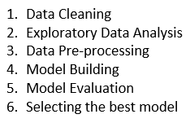
Technical Requirements
We have We have to made car price valuation model. This project contains two phases:
Data Collection Phase: We have scraped more than 5000 used cars data from websites: cardekho, Olx and cars24. We have fetched data for different locations. All types of cars are present in data for example- SUV, Sedans, Coupe, minivan, Hatchback. After scraping converted into csv file.
Model Building Phase: After collecting the data, built a machine learning model. Before model building have done all data pre-processing steps. Tried different models with different hyper parameters and selected the best model. Followed the complete life cycle of data science. Include all the steps like:

Slide 6
EDA
Within this we need to check the following :
Total Numbers of Rows & Columns
All Column Name
Data type of all data
Null values in data
Any special character present or not
Drop irrelevant features
Replace duplicate values
Visualization

Slide 7
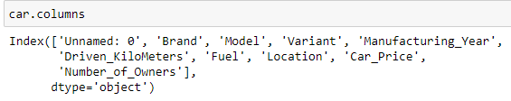
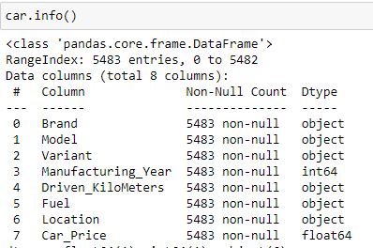
Data Description
The dataset contains 5616 records (rows) and 10 features (columns).
And after removal of irrelevant data and column, we remains with 5483 records (rows) and 8 features (columns).

Slide 8
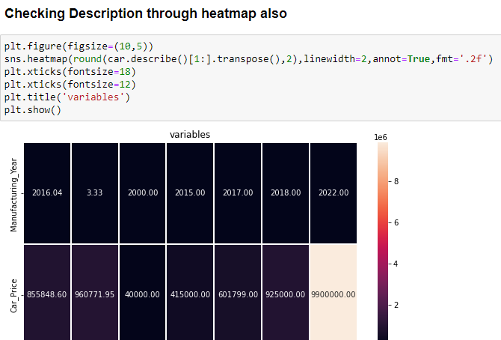
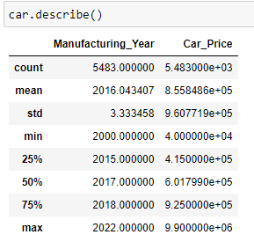
Dataset Description
Observation of DataSets:
There are no negative or invalid value present.
We can seen the count of “Manufacturing_Year” & “Car_Price” are equal which states there are no null values present in DataSet.
“Manufacturing_Year” contains Continuous Data.

Slide 9
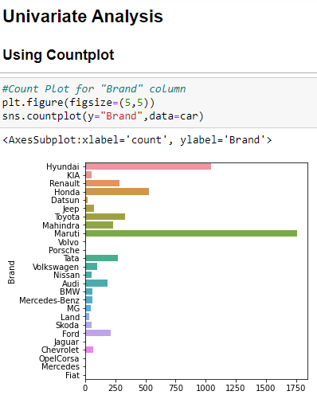
Data Visualization
Univariate Analysis using Countplot.

Slide 10

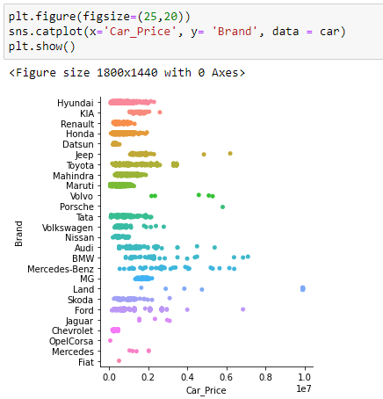
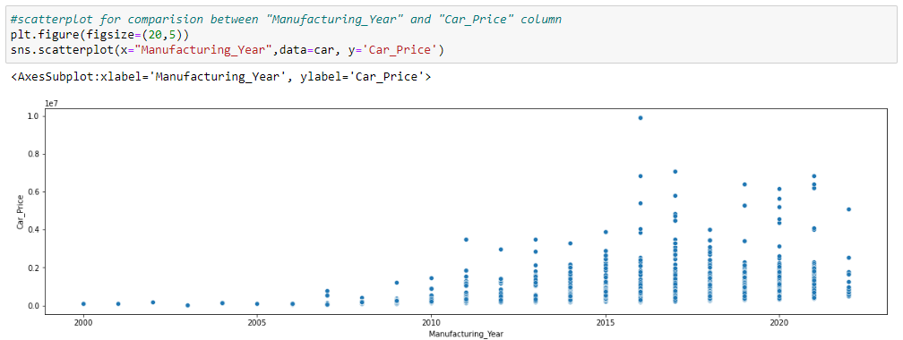
Data Visualization
Bivariate Analysis using Catplot and Scatterplot.

Slide 11
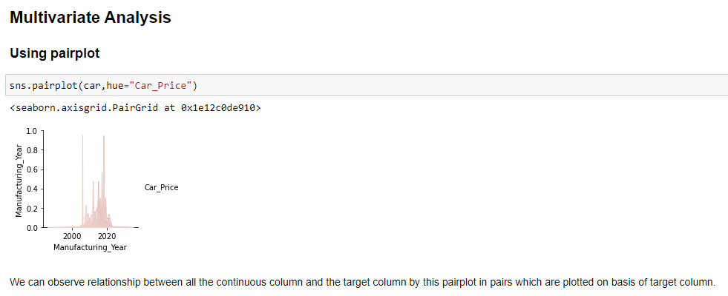
Data Visualization
Multivariate Analysis using Pairplot.

Slide 12
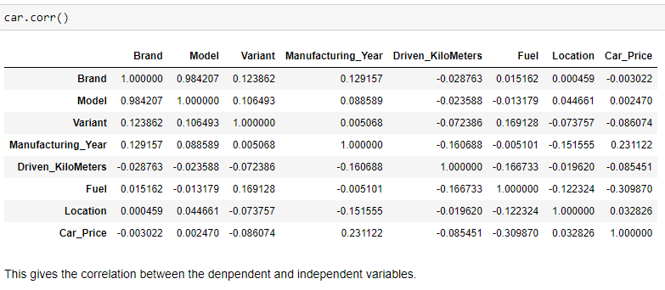
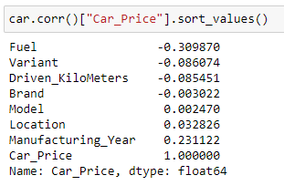
Co-Relation
All three columns are sorted in ascending order & showing strong relation with Targets.
Column ‘Fuel’ is positively co-related & column ‘Brand’ is negatively co-related with the target.

Slide 13
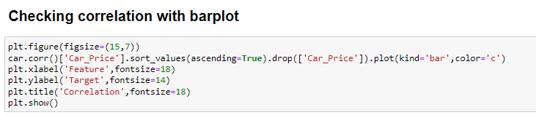
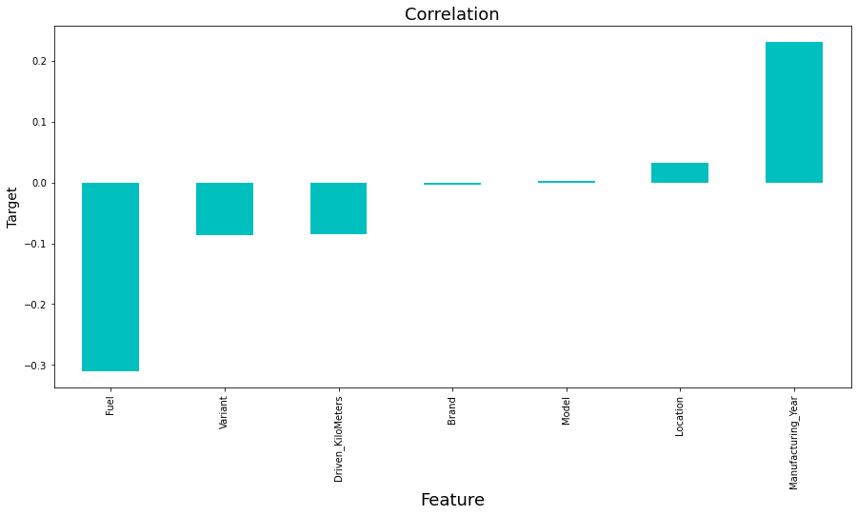

Slide 14

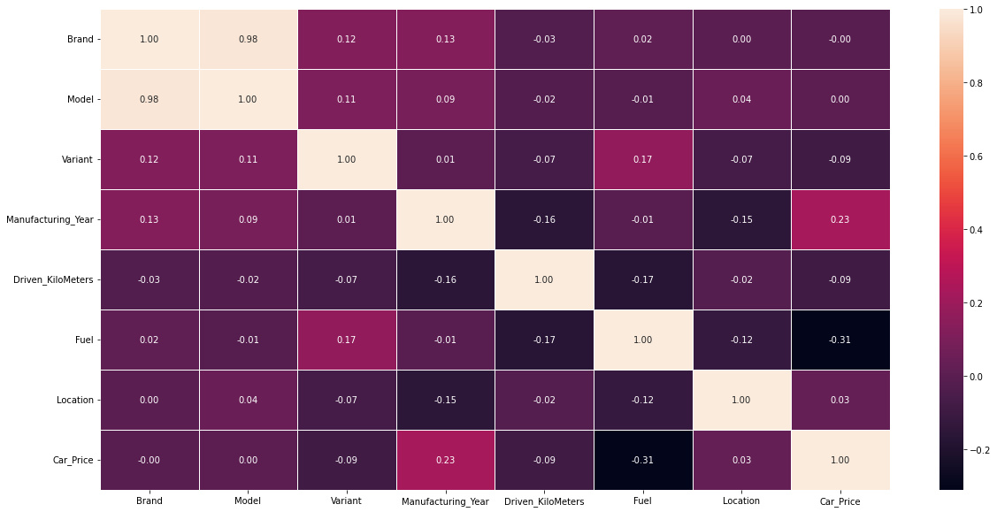

Slide 15
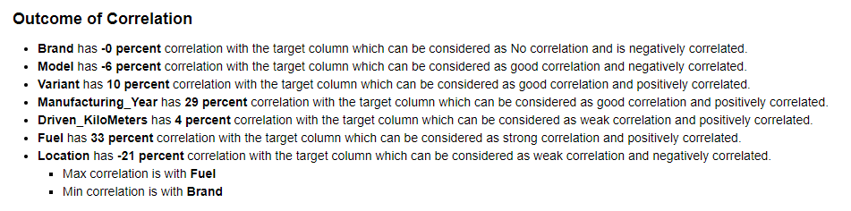
Outcome of Co-relation

Slide 16
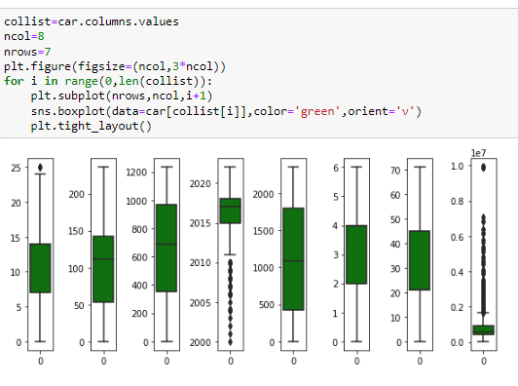
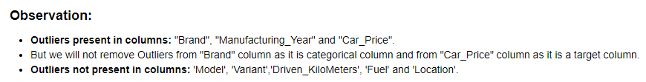
Outliers

Slide 17
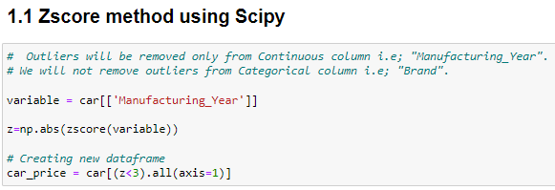
Removing Outliers
It can be removed only from the Continuous features not from Target column.
Checking two methods and compare between them which is give less percentage loss and then using that method for further process.
Zscore method using Scipy
IQR (Inter Quantile Range) method

Slide 18
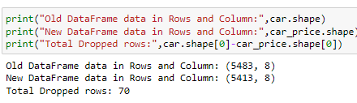
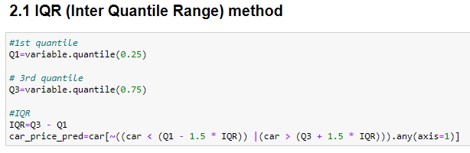
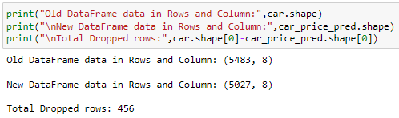
Comparing shape of old and new DataFrame after outliers removal
Comparing shape of old and new DataFrame after outliers removal

Slide 19
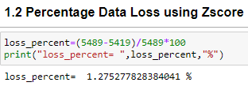
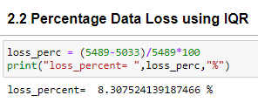
Comparing DataLoss using both method after Outlier Removal

Slide 20
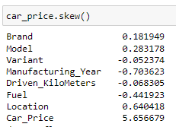
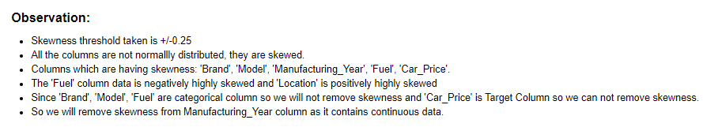
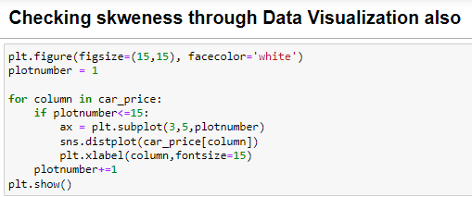
Skewness

Slide 21
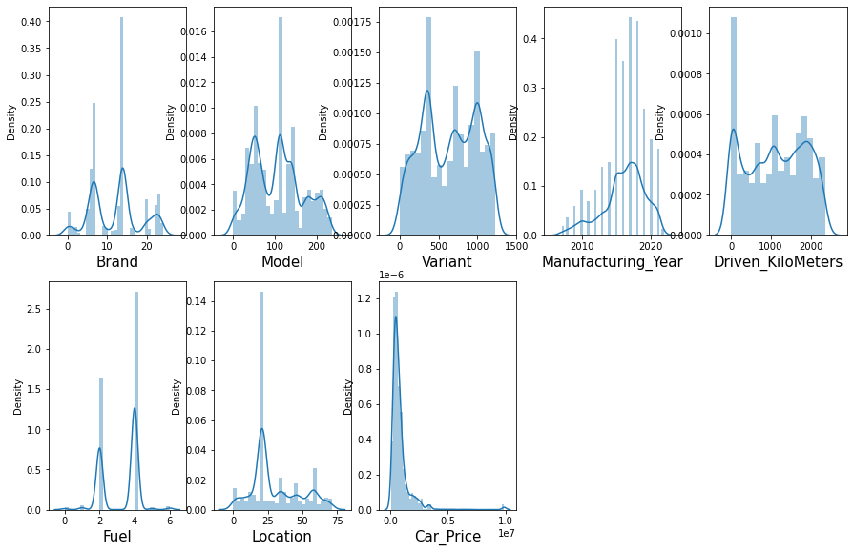
Skewness

Slide 22
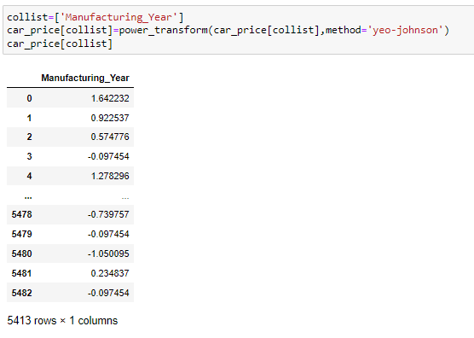
Removing Skewness
Using yeo-johnson method

Slide 23
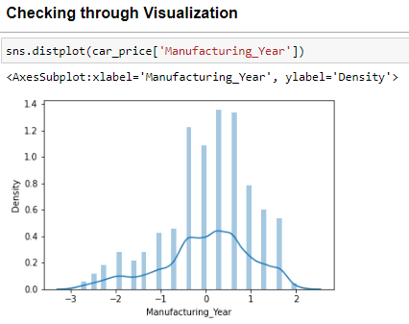
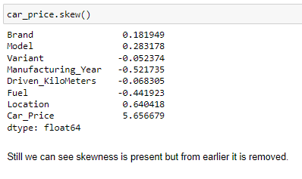
Skewness (After Removal)

Slide 24

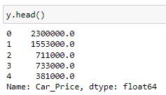
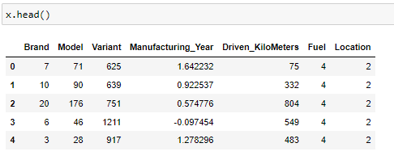
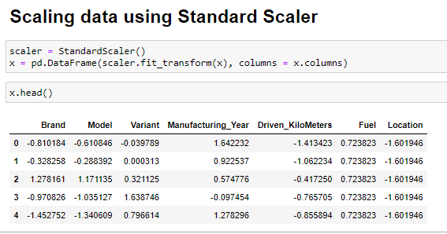

Data Pre-processing

Slide 25
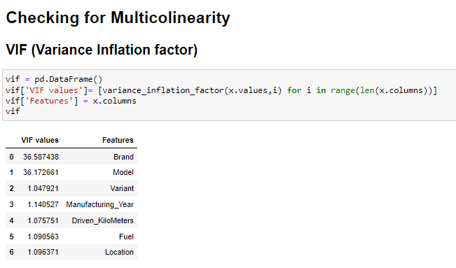
Data Pre-processing

Slide 26
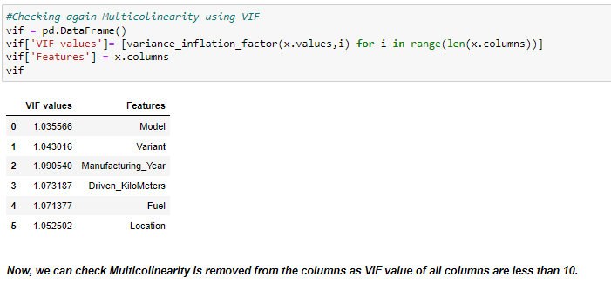
Data Pre-processing

Slide 27

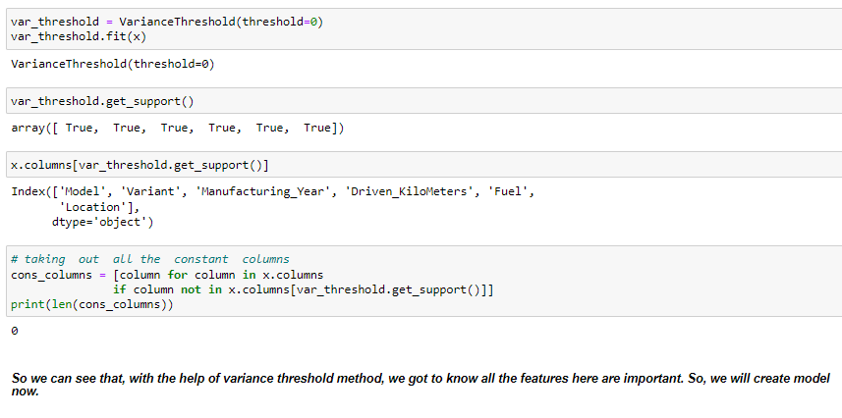
Data Pre-processing

Slide 28
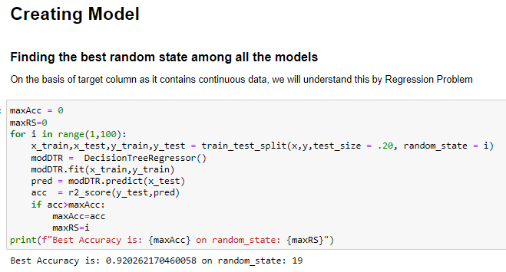
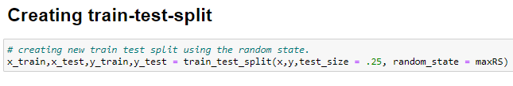
Data Pre-processing

Slide 29
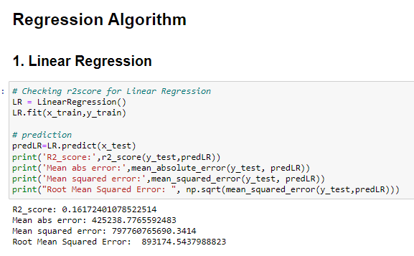
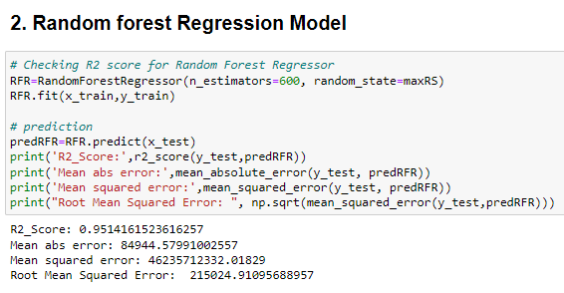
Data Pre-processing

Slide 30
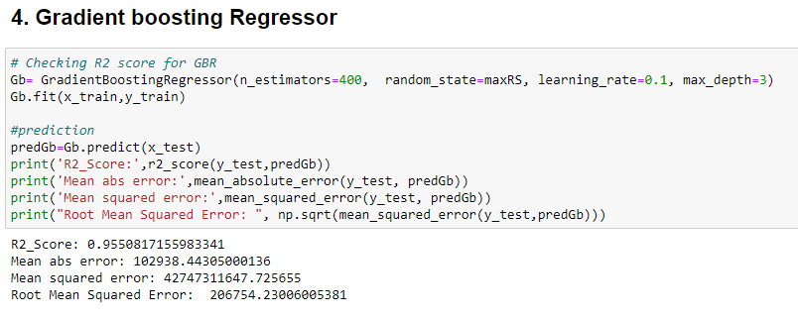
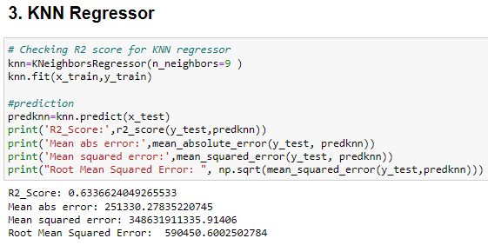
Data Pre-processing

Slide 31
Data Pre-processing

Slide 32
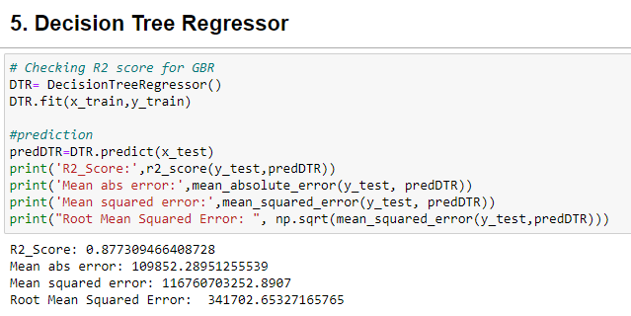
Data Pre-processing

Slide 33
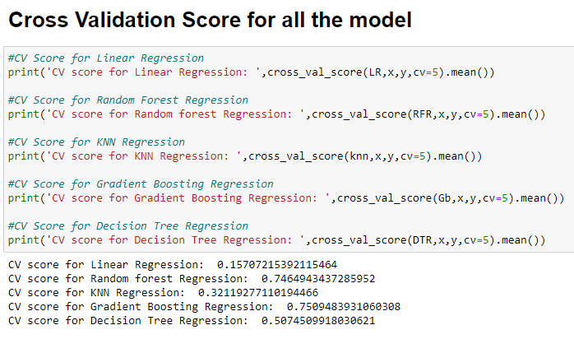
Cross Validation

Slide 34
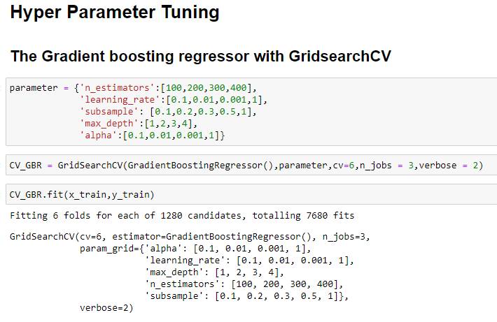
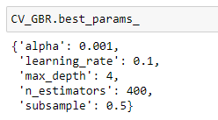
Hyper Parameter Tunning

Slide 35
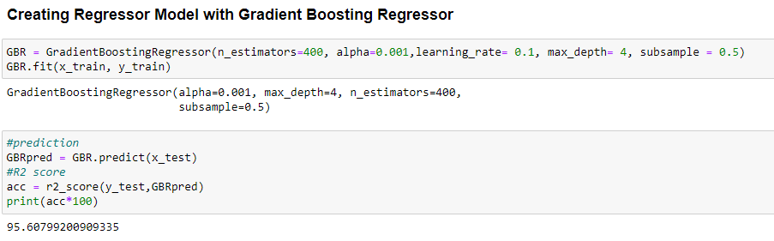
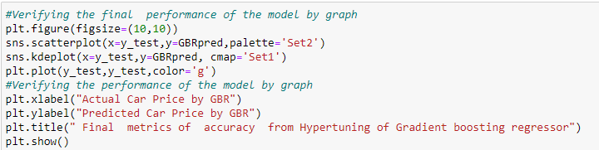
Hyper Parameter Tunning

Slide 36
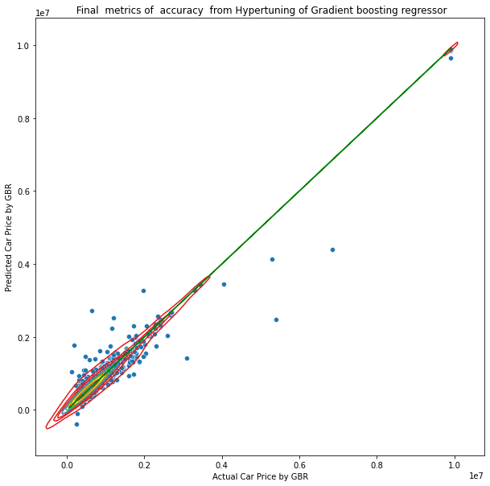
Hyper Parameter Tunning

Slide 37
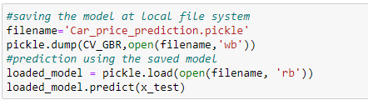

Final Steps
Saving the Model
Comparing Actual & Prediction

Slide 38



Slide 39



Slide 40

Saving model in CSV format

Slide 41
Summary
Here we have made a new car price valuation model as due to covid 19 impact previous car price valuation machine learning models is not working well because some cars are in demand hence making them costly and some are not in demand hence cheaper.
For new car price valuation model, we have done prediction on basis of Data using EDA, Data Cleaning, Data Visualization, Data Pre-processing, Checked Correlation, removed irrelevant features , Removed Outliers, Removed Skewness and at last train our data by splitting our data through train-test split process.
Built our model using 5 models and finally selected best model which was giving best accuracy that is Gradient Boosting Regressor. Then tunned our model through Hyper Tunning using GridSearchCV. And at last compared our predicted and Actual Price of Car. Thus our project is completed.

